Slide 1
MINE 304
Paper Presentation
Geological Domaining with Unsupervised Clustering
and Ensemble Support Vector Classification
Based on Koruk and Ortiz (2023)
Danial and Yerkebulan
Source paper: Koruk, K. and Ortiz, J. M. (2023), Mining, Metallurgy & Exploration.
1/29

Slide 2
Outline
▶
▶
▶
▶
▶
▶
▶
▶
Literature Review
Proposed Approach
Case Study
Results
Discussion & Conclusion
Objective
Problem Setting
Introduction
Geological Domaining with Ensemble SVC
2/29

Slide 3
Outline
▶
Introduction
▶
Problem Setting
▶
Objective
▶
Literature Review
▶
Proposed Approach
▶
Case Study
▶
Results
▶
Discussion & Conclusion
Geological Domaining with Ensemble SVC
2/29

Slide 4
Resource classification and reporting
Geological or estimation domains
Domain-based grade estimation
Drillhole logging and assays
Why Geological Domains Matter
Introduction
▶
Resource models first split the deposit into categorical geo-domains.
Grades are then estimated inside each domain
separately.
Domains should group samples with similar
geological and statistical behavior.
Poor domains can affect grade estimation.
From the course knowledge
Orebody evaluation is commonly separated into:
▶
1. Modelling categorical variables.
2. Estimating continuous grade variables
▶
▶
Geological Domaining with Ensemble SVC
3/29

Slide 5
From Logging to Estimation Domains
Introduction
▶
Geological domains may be based on lithology, alteration, mineralization, structure, or grade shells.
Modern mine planning also uses multi-element
geochemistry and geometallurgical variables.
Machine learning offers a way to combine
multiple variables.
Drillhole logging and assays
▶
Geological or estimation domains
▶
Domain-based grade estimation
Resource classification and reporting
Geological Domaining with Ensemble SVC
4/29

Slide 6
Problem Setting
Problem
Current Challenges
Consequence
▶
Biased resource estimation
Geological logging is subjective
Traditional geostatistical methods assume stationarity
Grade-shell domaining uses only grade information and ignores multivariate geochemical signals
Boundary uncertainty is rarely quantified
Incorrect NPV calculations
▶
Poor mine planning & scheduling
Domain boundaries lack continuity
▶
Low reproducibility between operators
▶
Geological Domaining with Ensemble SVC
5/29

Slide 7
Objective of the Paper
Problem
General objective
Develop a semi-automated, two-step ML workflow to define geological domains and quantify their uncertainties
▶
Unsupervised Classification
Supervised Interpolation
▶
Ensemble Learning
Hierarchical Application
▶
▶
Geological Domaining with Ensemble SVC
6/29

Slide 8
Literature Context
Problem
Traditional approaches
Machine learning approaches
▶ ▶
Multivariate geochemical clustering.
Neural networks and discriminant analysis.
Random forest and SVC.
Hybrid geostatistical and ML workflows.
▶
Manual wireframing.
Grade shells and cut-off domaining.
Indicator kriging and simulation.
Pluri-Gaussian simulation
▶ ▶ ▶
▶ ▶
Examples cited in the paper include Deutsch (2006), Faraj & Ortiz (2021), Moreira et al. (2020), Romary et al. (2012), Velasquez & Aguilar (2020), and Dumakor-Dupey & Arya (2021).
Geological Domaining with Ensemble SVC
7/29

Slide 9
Literature Context
Problem
Method | Reference | Limitation
Indicator Kriging / Sequential Indicator Simulation (BlockSIS) | Deutsch (2006) | Strong stationarity assumption and noisy probability models
Truncated / Pluri-Gaussian Simulation | Armstrong et al. (2011) | Complex parameterization and limited to categorical variables
Artificial Neural Networks & Discriminant Analysis | Harris & Pan (1999) | Requires labelled data and no spatial continuity imposed
Random Forest Classification | Cevik et al. (2021) | No spatial structure and independent sample predictions
Unsupervised Clustering (Faraj & Ortiz) | Faraj & Ortiz (2021) | Provides sample labels only - no volume interpolation
Gaussian Kernel SVC for Domains | Velasquez & Aguilar (2020) | Single model - no uncertainty quantification
Method
References
Limitation
Reference
Limitation
Geological Domaining with Ensemble SVC
7/29

Slide 10
Paper Contribution
Problem
▶
Combines geochemical clustering with spatial classification.
Uses variable subsets and sample subsets to create
weak learners.
Averages weak learners into a probability model for
domain membership.
Converts probabilities into categorical domain
boundaries.
Key idea
Domain knowledge selects variables;
▶
machine learning makes the classifica- tion reproducible and uncertainty-aware.
▶
▶
Geological Domaining with Ensemble SVC
8/29

Slide 11
Workflow at a Glance
Proposed Approach
Geochemical composites
Select relevant variables
Optimize log-normal distributions
Assign sample domain labels
Repeat hierarchically
Threshold into domains
Average model probabilities
Train many SVC models
Output
A categorical geological domain model and a probabilistic map of domain uncertainty.
Geological Domaining with Ensemble SVC
9/29

Slide 12


Step 1: Variable Selection and Distribution Unmixing
Proposed Approach
▶
Variables selected via geological knowledge & EDA
Single-domain populations -> log-normal
Global distribution = mixture of two domains.
Binary mixture
▶
▶
Geological Domaining with Ensemble SVC
10 / 29

Slide 13
Step 2: Assign Samples to Domains
Proposed Approach
▶
Random initial assignment at optimized proportion
Greedy swaps -> better match to target distributions
Final labels = SVC training classes.
Interpretation
▶
Each sample is assigned using multivariate behavior - not a single threshold.
▶
Geological Domaining with Ensemble SVC
11 / 29

Slide 14
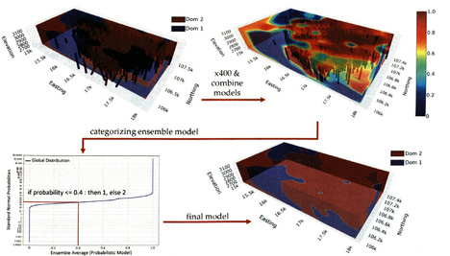
Step 3: Ensemble Support Vector Classification
Proposed Approach
▶
SVC learns the spatial boundary between labelled domains.
An RBF kernel allows curved, geologically
plausible contacts.
Models are repeated over subsets of
variables and samples.
Averaging creates a probability model
before categorization.
▶
▶
▶
Source: Koruk & Ortiz (2023).
Geological Domaining with Ensemble SVC
12 / 29

Slide 15

Performance Metric
Proposed Approach
Balanced accuracy
▶
Useful when domain sample counts are not equal.
Penalizes poor prediction of either class.
Used for validation of individual SVC models and final models.
▶ ▶
Geological Domaining with Ensemble SVC
13 / 29

Slide 16
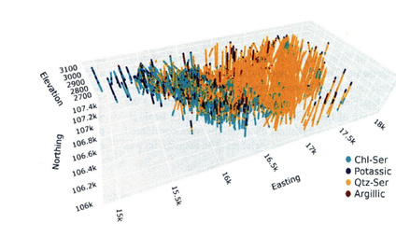
Case Study: Porphyry Copper Deposit
Case Study
▶ ▶ ▶
Approximately 21,000 composites. Composite length: 15 m.
Data include geochemical
concentrations and logging information.
Logging is used for comparison, not
for training the workflow.
▶
Source: Koruk & Ortiz (2023).
Geological Domaining with Ensemble SVC
14 / 29

Slide 17
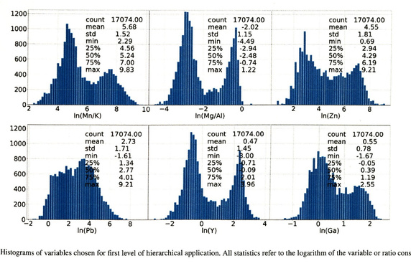
First-Level Variables
Case Study
▶ 50 available geochemical
elements.
▶ Six variables selected for
the first split.
▶ Goal: separate
chlorite-sericite/potassic from quartz-sericite/argillic groups.
Selected: Zn, Pb, Y, Ga, Mn/K, Mg/Al.
Source: Koruk & Ortiz (2023).
Geological Domaining with Ensemble SVC
15 / 29

Slide 18
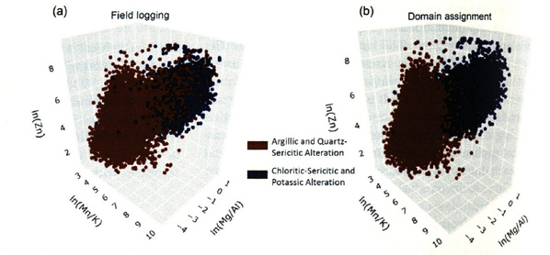
Logging Compared with Domain Assignment
Case Study
Source: Koruk & Ortiz (2023).
The unsupervised assignment reproduces a broad geological split without directly using the logging labels.
Geological Domaining with Ensemble SVC
16 / 29

Slide 19
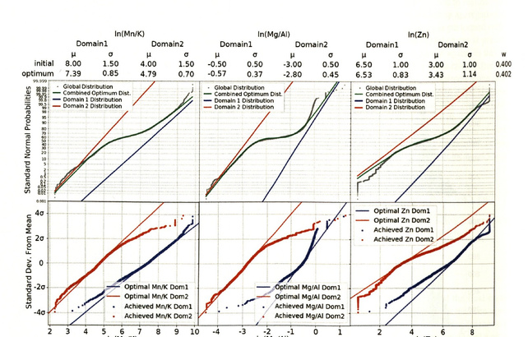
Optimization and Sample Assignment
Case Study
▶
The optimized mixture fits the global distribution.
The assigned samples
then approximate the
two target distributions.
Departures indicate local
complexity and possible
sub-populations.
▶
▶
Source: Koruk & Ortiz (2023).
Geological Domaining with Ensemble SVC
17 / 29

Slide 20
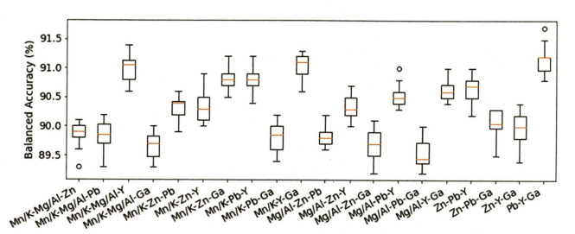
Binary Ensemble Results
Results
Result
91.3%
balanced accuracy for the final binary model
▶ ▶
Individual models were around 90.5%.
The ensemble produced a smooth binary
domain boundary.
Thresholding followed the optimized domain
proportion.
Source: Koruk & Ortiz (2023).
▶
Geological Domaining with Ensemble SVC
18 / 29

Slide 21
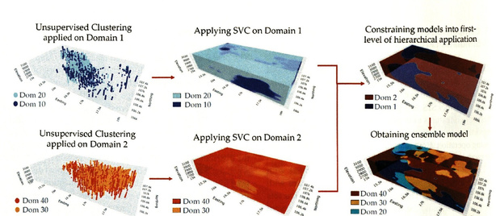
Hierarchical Extension to Four Domains
Results
▶
The binary workflow is repeated inside each first-level domain.
Domain 1 is split into
chlorite-sericite and potassic groups.
Domain 2 is split into
quartz-sericite and argillic groups.
Final output: four categorical
domains.
▶
▶
▶
Source: Koruk & Ortiz (2023).
Geological Domaining with Ensemble SVC
19 / 29

Slide 22
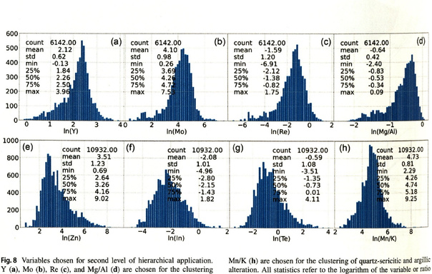
Second-Level Variables
Results
Domain 1 split
Y, Mo, Re, Mg/Al
Domain 2 split
Zn, In, Te, Mn/K
▶ Variable choice remains
geological and statistical.
▶ The second-level splits are
more difficult than the first.
Source: Koruk & Ortiz (2023).
Geological Domaining with Ensemble SVC
20 / 29

Slide 23
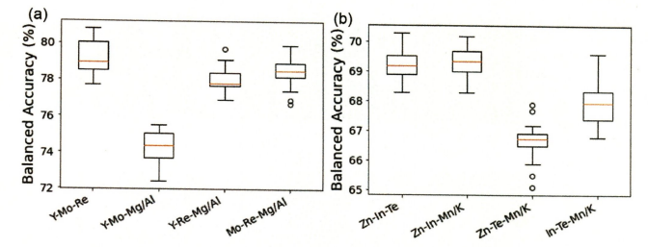
Four-Domain Model Performance
Results
Final hierarchical model
73.0%
balanced accuracy with four domains
▶ ▶ ▶
Chlorite-sericite/potassic split: 72–81%. Quartz-sericite/argillic split: 65–71%. Error propagation is the main hierarchical
risk.
Source: Koruk & Ortiz (2023).
Geological Domaining with Ensemble SVC
21 / 29

Slide 24
Benchmark Against BlockSIS
Results
Model Ensemble SVC
BlockSIS
Binary domains 91.3%
92.5%
Four domains 73.0%
69.4%
▶ ▶ ▶
Binary performance was comparable between both methods.
The ensemble SVC model outperformed BlockSIS in the four-domain case.
The paper emphasizes smoother, more continuous boundaries for the ensemble model.
Source: Koruk & Ortiz (2023).
Geological Domaining with Ensemble SVC
22 / 29

Slide 25
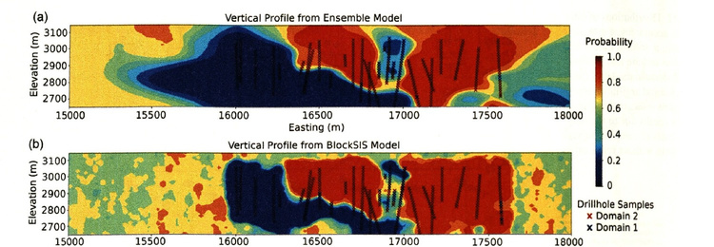
Binary Cross-Section Comparison
Results
Source: Koruk & Ortiz (2023).
In the binary case, both methods are accurate, but the ensemble model produces a more coherent
probability field.
Geological Domaining with Ensemble SVC
23 / 29

Slide 26
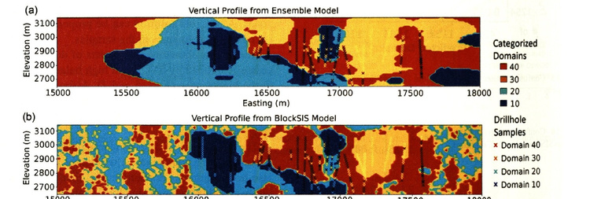
Four-Domain Cross-Section Comparison
Results
Source: Koruk & Ortiz (2023).
The four-domain BlockSIS result is visibly noisier, while the hierarchical ensemble model keeps broader
continuous domains.
Geological Domaining with Ensemble SVC
24 / 29

Slide 27
Advantages of the Proposed Method
Discussion
▶
▶
▶
▶
▶
Technical advantages
Limitation
Future work
▶
▶
▶
▶
▶
▶
Geological Domaining with Ensemble SVC
25 / 29

Slide 28
Advantages of the Proposed Method
Discussion
Technical advantages
▶
▶
▶
▶
▶
Uses multivariate geochemical information. Allows domain knowledge in variable selection. Produces probability maps, not only hard
labels.
Controls boundary smoothness through SVC
parameters.
Limitation
Future work
▶
▶
▶
▶
▶
▶
▶
Geological Domaining with Ensemble SVC
25 / 29

Slide 29
Advantages of the Proposed Method
Discussion
Limitation
▶
▶
▶
▶
▶
Variable selection strongly controls the outcome.
Binary hierarchy can propagate early mistakes.
Oversampled zones may bias optimized global proportions.
Log-normal assumptions may not hold for all
elements.
Technical advantages
Future work
▶
▶
▶
▶
▶
▶
▶
Geological Domaining with Ensemble SVC
25 / 29

Slide 30
Advantages of the Proposed Method
Discussion
Future work
▶
▶
▶
▶
Test multi-class clustering directly.
Apply declustering before estimating domain
proportions.
Compare with random forest and other
classifiers.
Validate domains against independent
geological interpretation.
▶
Technical advantages
Limitation
▶
▶
▶
▶
▶
▶
▶
Geological Domaining with Ensemble SVC
25 / 29

Slide 31
Conclusion
Discussion
▶ ▶ ▶ ▶
The paper presents a practical workflow for geological domaining using geochemical data.
Unsupervised clustering -> geochemically consistent domain labels.
Ensemble SVC gives us continuous, smooth spatial domain models
Binary model matches BlockSIS and four-domain model outperforms
Key value: uncertainty-aware, reproducible domain definition
▶
What we have learned
Geological interpretation remains essential, but machine learning can make domaining more consistent,
transparent, and auditable.
Geological Domaining with Ensemble SVC
27 / 29

Slide 32
References
[1
Koruk, K., & Ortiz, J. M. (2023). Geological domaining with unsupervised clustering and ensemble support vector classification. Mining, Metallurgy & Exploration, 40, 2537–2549 doi:10.1007/s42461-023-00858-3
Faraj, F., & Ortiz, J. M. (2021). A simple unsupervised classification workflow for defining geological domains
using multivariate data. Mining, Metallurgy & Exploration, 38, 1609–1623.
Deutsch, C. V. (2006). A sequential indicator simulation program for categorical variables with point and block
data: BlockSIS. Computers & Geosciences, 32, 1669–1681.
Rossi, M. E., & Deutsch, C. V. (2014). Mineral Resource Estimation. Springer.
Madani, N. (2026). MINE 304 lecture slides: Geo-domain Modeling; Mineral Resource Classification.
[2
[3
[4 [5
Geological Domaining with Ensemble SVC
29 / 29

